Slide 1

Loan Data Analysis
A Machine Learning Approach to Online Lending

Slide 2
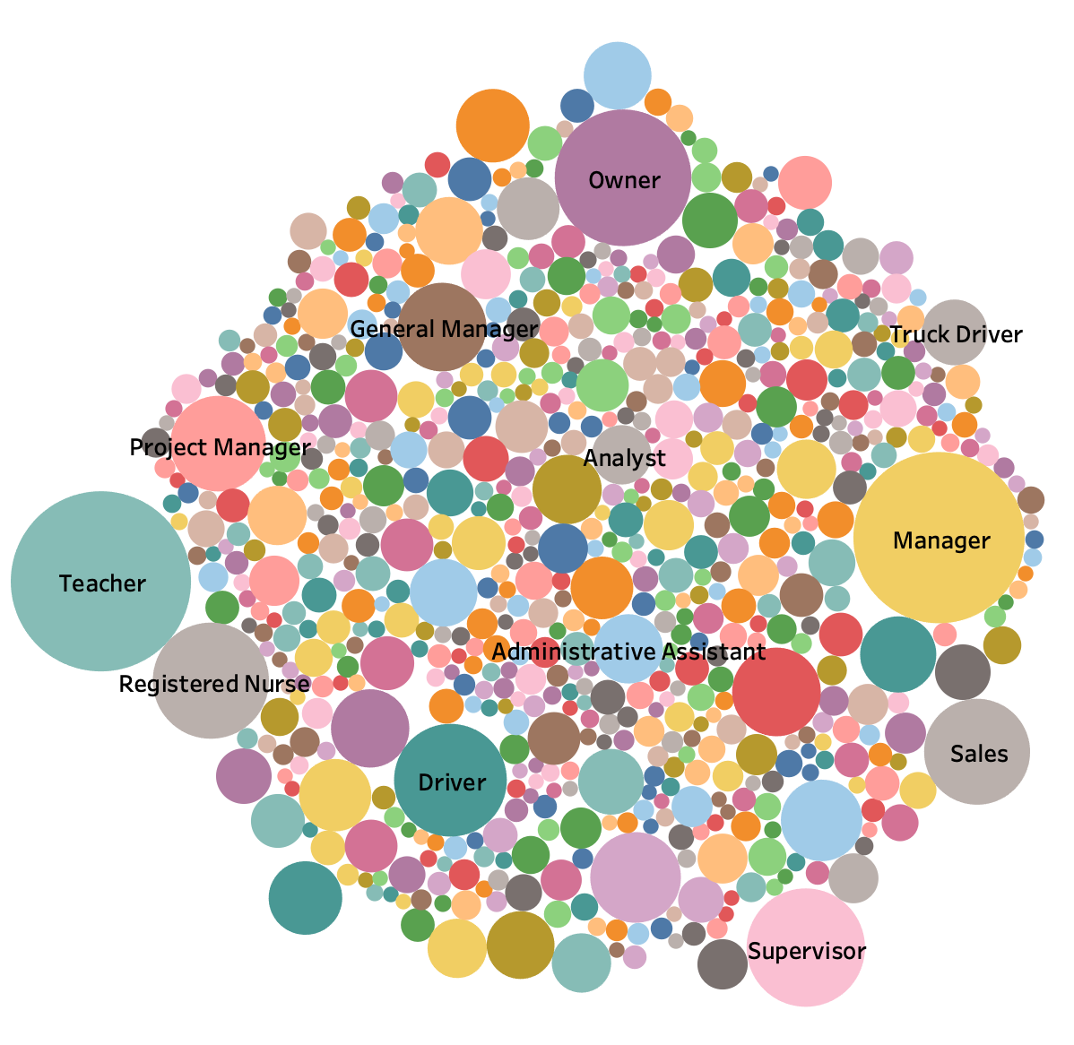
Why do people need loans?
This graph shows the number of loans taken out during 2007-2018, where the size of the bubble infers the amount of loans taken by occupation.
Notes:
Why do people need loans ? (this is from our data)
Why did

Slide 3

Analysis
This project uses data to achieve the following purposes:
Use historical loans to determine if a request is accepted or rejected.
Build on that data set to determine what range the interest rate will be for accepted loans.
This will help provide individuals looking for a loan the ability to see what they qualify for.
Notes:
Talk about why people need loans ?
Based on rubric

Slide 4






Technologies, Language and Tools

Slide 5
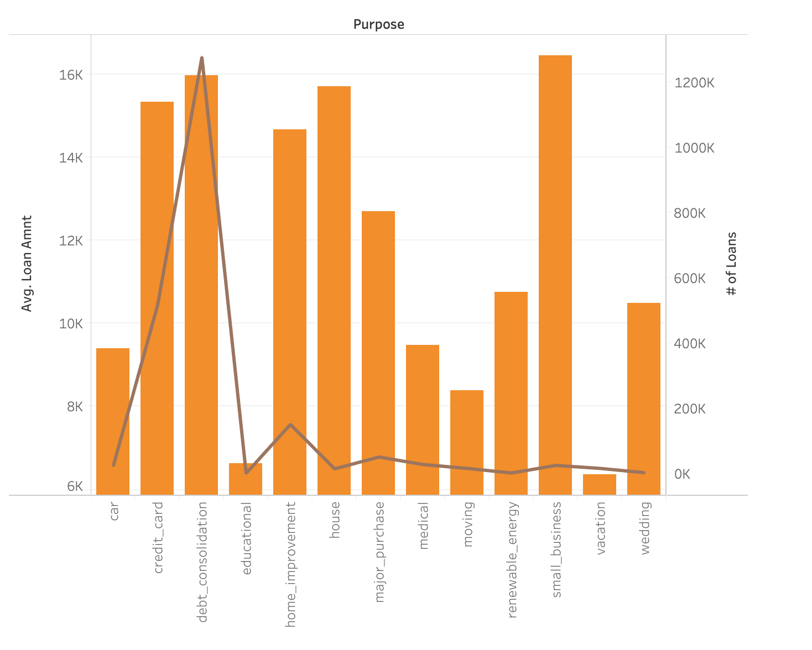
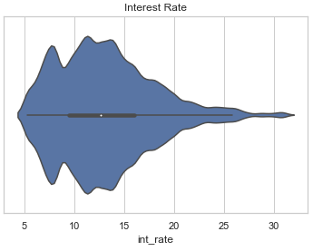
Loan Statistics
Key Insights
Employment Length contributed more than Debt to Income Ratio (DTI).
Loan Amount was a key factor in acceptance and rejection.
The average loan was around 11K but varied when viewed by purpose (orange bars).
The graph depicts that the majority of loans approved were for the purpose of debt consolidation (brown line).
Most interest rates were between 10-15%.
Notes:
Sample rate =

Slide 6
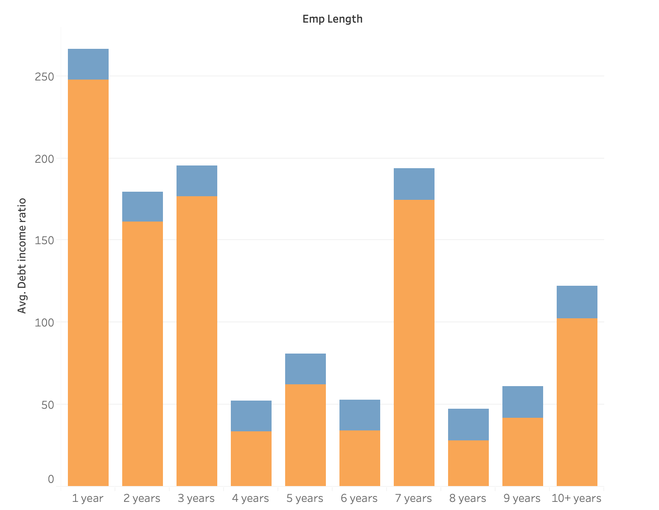
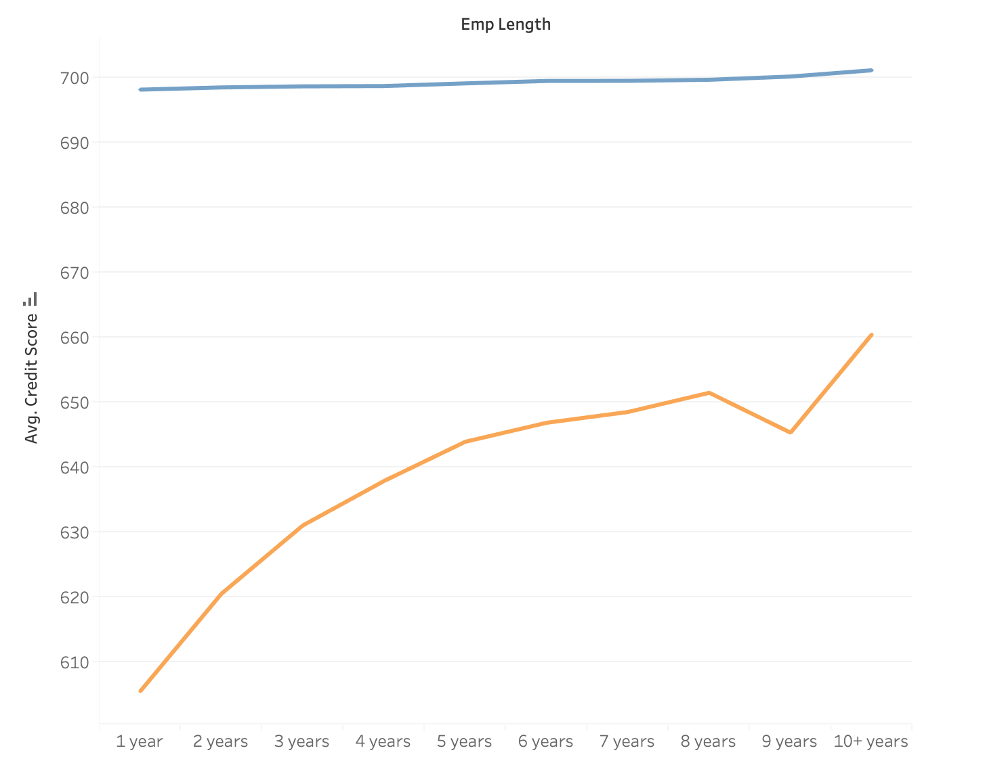
Candidates for a successful loan
Approved
Rejected
We see that with successful candidates, they have a high credit score and a small DTI (debt to income ratio).
We see with rejected candidates, the avg credit score is way lower while the DTI bars depicts a wide ratio.

Slide 7
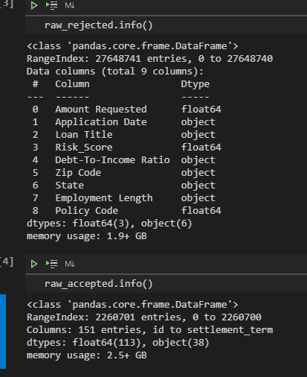
Data Analysis - Cleaning and Preprocessing
Large dataset spanning from 2007 to 2017 consisting of over 28 million entries.
Key Challenges:
18 million Null entries
151 columns
Numerical / Categorical
Separate .csv files
Solutions:
Consolidate and conquer
Impute values and Dropna()

Slide 8
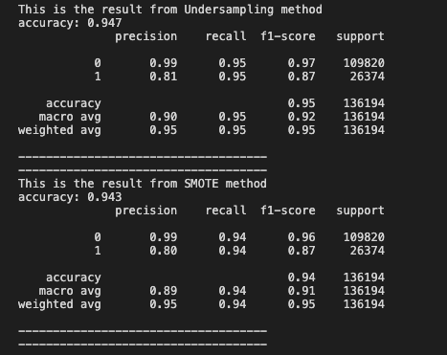
Loan Approval Data Model - Classification
Loan Approval Model : Classification
Key Takeaways:
Class Imbalance Correction
Optimize number of selectors
Iterate over different model and sampling

Slide 9
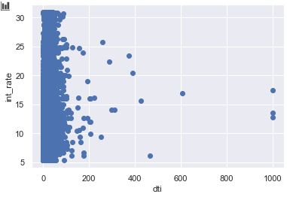
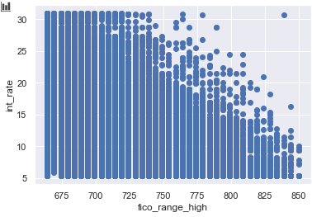
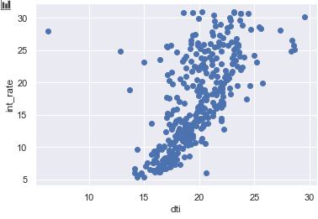
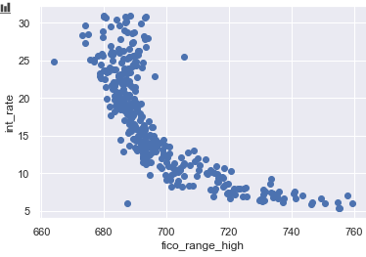
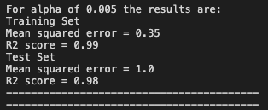
Interest Rate Data Model - Regression
Key Takeaways:
Group by target variable
Ridge and Lasso Regression
Optimize ‘alpha’ values
Feature selection

Slide 10
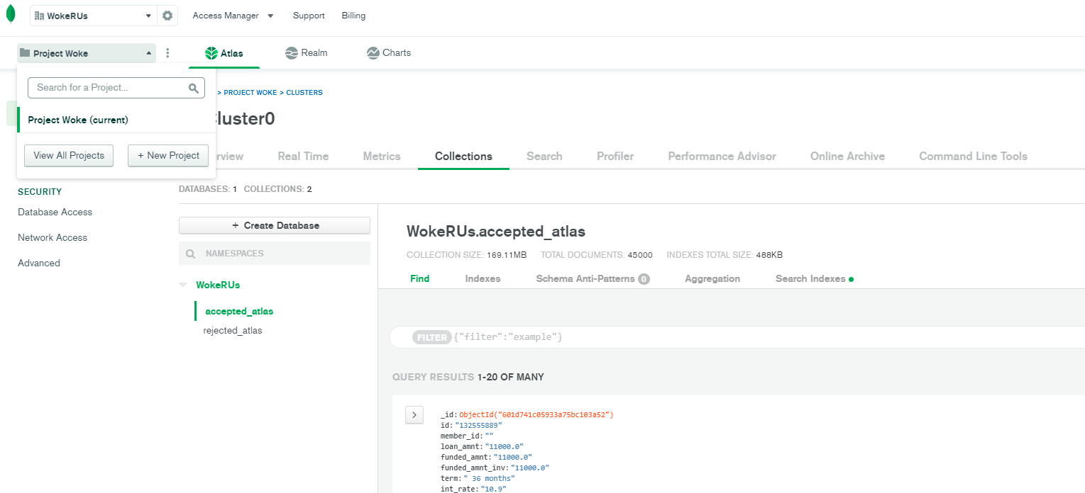
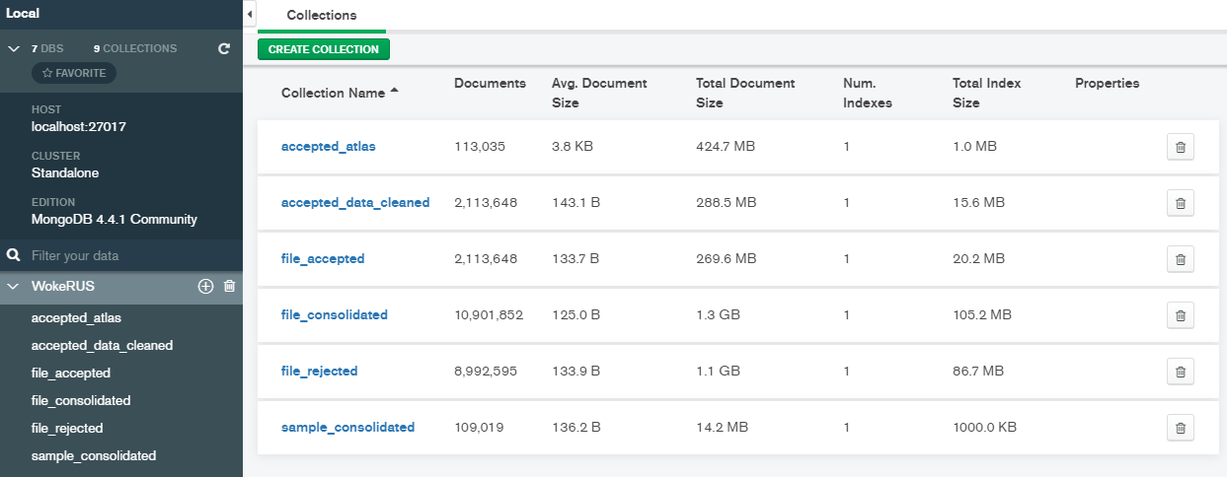
Database Setup / Selection / Integration
Key Takeaways:
Ease of access to project collaborators.
Free to use, though some limitations.
MongoDB was preferred database as it is was easy to store and retrieve documents quickly.
Choosing the right webapp - challenge to integrate our database and deploy our web app. (Challenge)

Slide 11
Web App Deployment (Flask)
A quick demonstration of our working model and Database connection

Slide 12
Lessons Learned and Recommendations for Future Analyses
Limitations on cloud storage and dataset size.
Integrated everything to local database, but due to restrictions we could not put everything on the cloud (too big files).
Find more updated data (this data only goes to 2018).
Use NLP or different method to try and classify rejected loan titles.
Use a cloud web deployment platform to store and manage data.

Slide 13
QUESTIONS?

